Slide 1
Consumer Goods
Unit 6

Slide 2
Shopping Product
Shopping product are the goods that the consumer chooses and makes the buying decision based on style, price, quality, and stability. People don’t buy shopping products often. In fact, they plan for it and make a comparison among the style, quality, design, and price of the various brands. Consumers usually spend a lot of time getting the information and making comparisons among various shopping products. Examples of shopping products include furniture, clothing, used cars, airline services etc. As you can see, such products are a little more involving: they require more time, thinking and investment than convenience products.
For example, while purchasing clothes or fashion apparel, customers try different styles and compare their quality, material, and price before deciding. It’s a similar case with furniture and electronic gadgets where the customer weighs attributes of a variety of similar products before purchasing the product.
These products witness non-regular purchases and usually have high prices per unit. Hence, the customers compare products’ attributes such as quality, price, and style with their alternatives and spend some time before making the final purchase decision.

Slide 3
Feature of Shopping
Full information about the products.
Having unique characteristics.
Price is generally high.
Purchased infrequently.
Limited demand and number of buyer.
It is affected by fad and fashion.
Packaging is less important.
Offer high status in mind.

Slide 4
Market Consideration
Marketing strategies for shopping products are a bit different. They are usually distributed through fewer outlets, but with deeper sales support in order to help customers in the comparison effort. Also, the price is usually much higher than for convenience products. In addition, personal selling becomes a key strategy. Think about a used car – clearly this carries a different price tag than even the most expensive sugar you can find on the shelves. In terms of promotion, you would typically consider more targeted advertising, both online (e.g., Instagram ads) and offline (e.g., flyers, billboard ads etc.). Think about that used car again – can you imagine the used car dealer trying to convince you to buy it?
Shopping products, like electronics, require a more thoughtful approach. The product needs to offer compelling features and benefits. Pricing is competitive, and the place often includes physical stores and online platforms. Promotions for these products involve detailed product information and comparisons.

Slide 5
Specialty Product
Specialty products are goods that have strong brand loyalty and preference, and a little price sensitivity and brand comparison. Such brand products have got unique features that differentiate their brand from the rest. It becomes a habit of customers to buy brand products. Specialty products have a high level of differentiation and people could easily recognize the brand products. The customers would search for them actively. For example, photographic equipment, tech component, healthy food, fancy groceries, and men’s clothes. The unique features of the specialty products would attract the attention of customers. It makes them search for it. Here they don’t want the substitute brand; instead, they would spend a considerable time and effort to find their brand. Specialty products are usually costly consisting of a high-profit margin, and you could only find them in the limited stores. The reason they’re available in a limited number of stores because the customers won’t accept the brand from any store.

Slide 6
Examples of specialty products include expensive cars, professional photographic equipment, designer clothes etc. A perfect example for specialty products is a Ferrari. In order to buy one, a certain group of buyers would make a special effort, for instance by travelling great distances to buy one. However, specialty products are usually less compared against each other. Rather, the effort must be understood in terms of other factors. Buyers for instance invest more time to reach dealers that carry the wanted products.

Slide 7
Features
Consumer have full knowledge about the product.
High price.
Purchased infrequently.
Pre-planned purchased.
Packaging is less important.
Limited demand and limited number of buyer.
Less comparison.
Offer high status in mind.
Effected by fad and fashion.

Slide 8
Market Consideration
Specialty products, such as luxury goods or unique crafts, demand a different strategy as the product must be distinctive and high-quality. Pricing is typically high, reflecting the product's exclusivity. These products might be sold in specific locations or exclusive online platforms. Promotion for specialty items often focuses on the unique selling proposition and brand story.
Specialty products are exclusively distributed. As a result, brick and mortar locations need to consider whether there is large demand in the geographic area to justify selling specialty products. Typically, billboards advertising specialty products are situated in luxury, urban areas to drive consumers to local stores. Specialty products are targeted towards a niche clientele. Therefore, these products will likely be marketed in high-end fashion magazines. These ads will also require personalization to appeal to an elite class of shoppers.

Slide 9
Unsought Product
Unsought products are those consumer products that a consumer either does not know about or knows about but does not consider buying under normal conditions. Thus, consumers do not think about these products under normal circumstances, at least not until they need them. Consumers usually don’t choose to buy an unsought product if they come across it unless there’s a promotion for it. They don’t make any conscious effort and intentionally look for unsought products.

Slide 10
Features
Rarely purchased.
No purchase planning
Branding is less important
Prices varies according to the product.
Bought at specific outlet.

Slide 11
Market Consideration
As a consequence of their nature, unsought products require much more advertising, selling and marketing efforts than other types of consumer products. In many cases, aggressive advertising and personal selling is a requirement. Prices can vary a lot and really depend on the specific product. Ideally, you apply the pricing strategy that is most suited to the product characteristics. All your efforts should focus on creating awareness and a perceived need for your product. Therefore, demonstrating the product, emphasizing its benefits and offering an attractive price are key to success.
Unsought products, like insurance policies, require marketers to educate consumers about the product's needs and benefits. Pricing strategies could include installment plans, while promotion often involves personal selling and aggressive advertising.

Slide 12
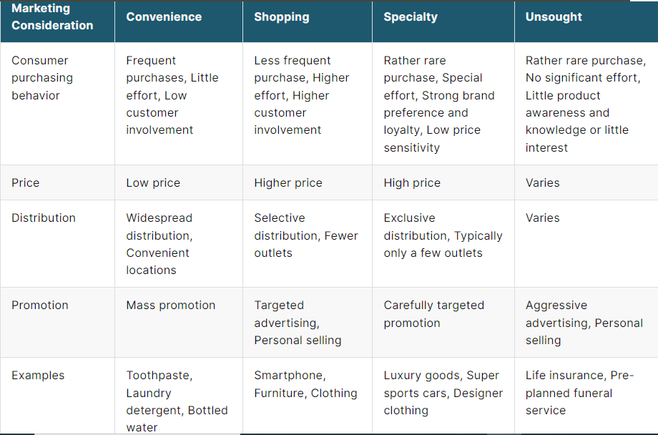

Slide 13

Thank you

